Slide 1




Dr.Ranjit K.N
Hod CSE Dept
MAHARAJA INSTITUTE OF TECHNOLOGY THANDAVAPURA
DEPARTMENT OF COMPUTER SCIENCE AND ENGINEERING
MAJOR PROJECT
BLOCK CHAIN BASED NATIONAL
DIGITAL COIN(NDC)
Ganesh A kashyap
Pavan
UNDER THE GUIDANCE OF:
Shashank v kashyap
Prof. Madhu B
PROFESSOR
DEPT OF CSE
Dhanjay

Slide 2



INTRODUCTION
As the world moves toward a digital-first financial ecosystem, traditional fiat currencies are evolving to meet the demands of modern economies. National Digital Currencies (NDCs), powered by blockchain and Web3 technologies, offer a secure, transparent, and efficient alternative to physical cash and traditional banking systems. Unlike cryptocurrencies, NDCs are state-backed digital assets that maintain regulatory compliance while leveraging the benefits of decentralization.
This project aims to develop a next-generation NDC that combines the robustness of blockchain technology, smart contracts, and decentralized finance (DeFi) to create a highly scalable and tamper-proof financial infrastructure. The system ensures instant transactions, reduced fraud, enhanced security, and financial inclusion while maintaining regulatory oversight and government control.
By integrating cryptographic security, cross-border compatibility, and smart contract-driven automation, this digital currency will redefine national economies by providing a faster, more accessible, and future-proof alternative to conventional fiat currencies.

Slide 3
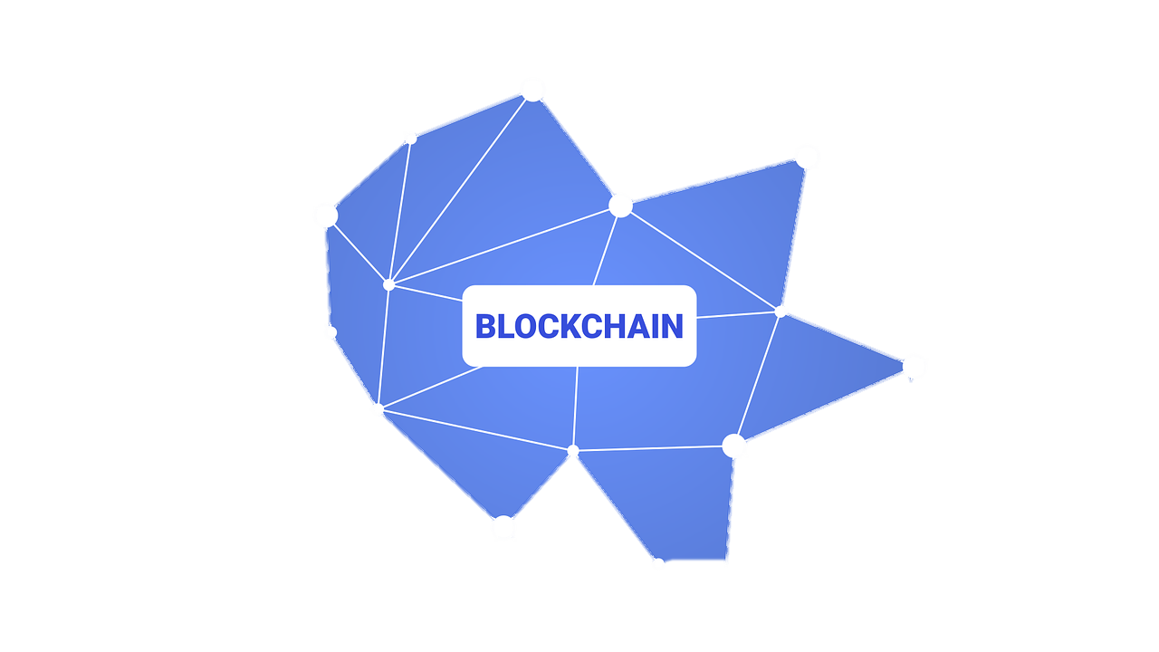

Problem Statement
Financial Mismanagement & Corruption – Lack of transparency in fund allocation leads to inefficiencies, corruption, and resource loss.
Absence of Secure Tracking – Traditional systems rely on centralized control, making transactions vulnerable to tampering and unauthorized modifications.
Government Project Challenges – Large funds for public services often face discrepancies, delays, and misallocations due to lack of real-time visibility.
Blockchain-Based Solution – A National Digital Currency (NDC) using blockchain and Web3 ensures secure, transparent, and immutable transactions.
Smart Contract Fund Tracking – Automates real-time monitoring, eliminating middlemen, enhancing accountability, and streamlining auditing.

Slide 4



Existing System Drawbacks
Lack of Transparency – Centralized financial systems make it difficult to track fund flow, leading to corruption and mismanagement.
Manual & Inefficient Auditing – Traditional financial systems rely on manual processes, making auditing slow and prone to errors or manipulation.
High Intermediary Involvement – Multiple intermediaries in transactions increase costs, delays, and opportunities for fund diversion.
Security Vulnerabilities – Centralized databases are susceptible to cyberattacks, fraud, and unauthorized modifications.
Delayed Transactions – Government and financial processes often involve bureaucratic delays, affecting real-time fund utilization.
Lack of Real-Time Tracking – No real-time visibility into fund distribution results in inefficiencies and misallocation.

Slide 5

Proposed System Advantages & Overcoming Drawbacks
1 Decentralization & Elimination of Intermediaries: Drawback Overcome: Traditional banking systems rely on centralized institutions that can be slow, expensive, and prone to failure. Solution:
Blockchain removes the need for central authorities, making transactions peer-to-peer (P2P).
Eliminates bank failures, excessive fees, and processing delays.
2 Enhanced Security & Fraud Prevention: Drawback Overcome: Traditional digital payment systems are vulnerable to hacking, identity theft, and double spending. Solution:
Uses cryptographic encryption & consensus mechanisms (PoW/PoS) to prevent fraud.
Transactions are immutable, meaning they cannot be altered or deleted.
3 Transparency & Traceability: Drawback Overcome: Cash transactions allow money laundering, corruption, and tax evasion due to a lack of transparency. Solution:
Every transaction is recorded on the blockchain, making it publicly verifiable.
Ensures end-to-end transparency while maintaining user privacy.
4 Improved Monetary Policy Control: Drawback Overcome: Traditional cash-based economies make it hard for central banks to track and control money supply. Solution:
Blockchain-based NDC allows real-time monitoring of circulation.
Authorities can control inflation, prevent black money circulation, and stabilize the economy.

Slide 6
SOFTWARE DEVELOPMENT GUIDE
Security & Encryption
Use AES-256 encryption for data storage and TLS 1.3 for secure communication.
Implement multi-signature wallets to prevent unauthorized transactions.
Ensure smart contract security by auditing for vulnerabilities like reentrancy attacks.
Scalability & Performance
Optimize block validation time to ensure fast transactions.
Use Layer-2 scaling solutions (like Rollups) to reduce congestion.
Implement efficient consensus mechanisms (e.g., Proof-of-Stake for better efficiency).
Data Integrity & Transparency
Store transaction history in a tamper-proof blockchain ledger.
Implement zero-knowledge proofs (ZKPs) for privacy without compromising transparency.
Use hashing (SHA-256) to ensure data immutability.
Compliance & Legal Considerations
Follow GDPR and data protection laws for user privacy.
Ensure interoperability with existing financial systems (e.g., SWIFT, UPI, etc.).
Fault Tolerance & Recovery
Implement automatic rollback mechanisms for failed transactions.
Maintain a redundant node system to ensure uptime.
Regularly update backup strategies to prevent data loss.

Slide 7

QUESTIONS
THANKYOU

